Slide 1

Analyzing Technological Trends in Autonomous Vehicles through Patent Text Mining and Predictive Modeling
Zeroth Review
Natural Language Processing
Course Code: CS7610
Course Title: Capstone Project
Guide Name: Prof. Ramya Mohanakrishnan
24MSP3038
Aniket Shinde
06/06/2025

Slide 2
State University of New York at Binghamton
Master of Science in Computer Science
Dr. Patrick H. Chen
Natural Language Processing

Slide 3
Problem Statement
Patents are a valuable source of early-stage technological insights, offering structured disclosures of innovation across industries. In the rapidly evolving autonomous vehicle (AV) domain, analyzing patent text can reveal emerging trends, key technologies, and innovation gaps. This project applies Natural Language Processing (NLP) to extract structured knowledge from AV-related patents. By identifying key terms and relationships, we build semantic representations of each document. These are then used in machine learning techniques such as clustering and dimensionality reduction to uncover hidden patterns and technology clusters. The goal is to demonstrate how AI-driven patent analysis can support trend forecasting and strategic R&D planning in the AV space.

Slide 4
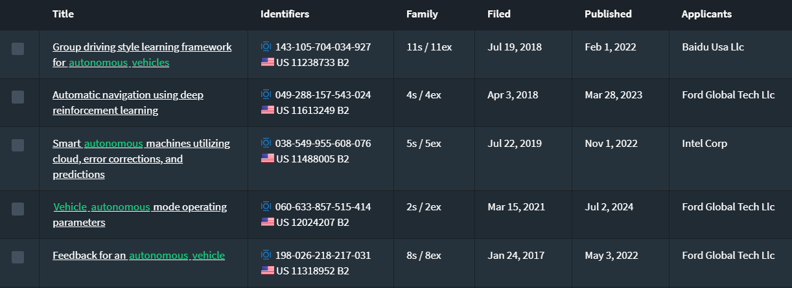
Dataset
Source of the Dataset: lens.org
No. of Observations: 667 full text files
Column/Feature Details: Title, Abstract, Claims, Application Date, Publication Date, Applicants, CPC Codes
Screenshot of the dataset:

Slide 5
Review of Related Literature
Base Paper:
Trappey, A. J. C., Trappey, C. V., Wu, J.-L., & Wang, J. W. C. (2020). Intelligent compilation of patent summaries using machine learning and natural language processing techniques. Advanced Engineering Informatics, 43, 101027. https://doi.org/10.1016/j.aei.2019.101027
Link to Paper
Paper I:
Cho, R. L. T., Liu, J. S., & Ho, M. H. C. (2021). The development of autonomous driving technology: perspectives from patent citation analysis. Transport Reviews, 41(5), 685–711. https://doi.org/10.1080/01441647.2021.1879310
Link to Paper
Paper II:
Kim, G., & Bae, J. (2017). A novel approach to forecast promising technology through patent analysis. Technological Forecasting and Social Change, 117, 228–237. https://doi.org/10.1016/j.techfore.2016.11.023
Link to Paper
Paper III:
Lattimer, B., Chen, P. H., Zhang, X., & Yang, Y. (2023). Fast and accurate factual inconsistency detection over long documents. In H. Bouamor, J. Pino, & K. Bali (Eds.), Proceedings of the 2023 Conference on Empirical Methods in Natural Language Processing (pp. 1691-1703). Association for Computational Linguistics. https://doi.org/10.18653/v1/2023.emnlp-main.105
Link to Paper

Slide 6
Impact of the Proposed Research
This research enables data-driven insights into autonomous vehicle technology development by transforming complex patent text into structured data. It implements a scalable pipeline to identify technological trends, directions of innovation, and potential gaps in progress. These insights can support researchers, investors, and policymakers focused on advancing AV research.

